Slide 1
PPS STRINGS
SEMESTER:1ST SEM
PREPARED BY: Divya kushwah

Slide 2
Chapter 4 –ARRAY & STRING
Outline
String handling function

Slide 3
Introduction
This Functions operates on strings.
They are used to handle the strings.
For using this functions ,We have to specify the header file
strlen(s) - Gives the length of the string(number of character in string).
strcpy(s1,s2) - Copy s2 string to string s1.
strcmp(s1,s2)- Compare both string and return 0 if both the string are equal return positive value if s1 is greater than s2 and return negative value if s1 is less than s2
strrev(s) - returns the string in Reverse order.
strcat(s1,s2) - Concate the string s2 to s1

Slide 4
Introduction
strncmp(s1,s2,n) - Compare n numbers of character from both the string and return 0 if both the string are equal return positive value if s1 is greater than s2 and return negative value if s1 is less than s2
strcmpi(s1,s2) - Compare both string but ignore the cases and return 0 if both the string are equal return positive value if s1 is greater than s2 and return negative value if s1 is less than s2
strchr(s1,c) - Returns a pointer to the first occurence of the character c in string s1.
strrchr(s1,c) -Returns a pointer to the Last occurence of the character c in string s1.
strstr(s1,s2) - Returns a pointer to the first occurence of the string s2 in string s1.
strupr(s1) - Converts all the characters of string s1 with uppercase characters.
strlwr(s1) - Converts all the characters of string s1 with lowercase characters.

Slide 5
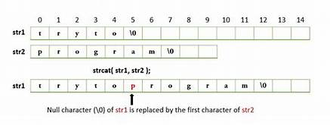
STRCAT()
The strcat function joins the strings together. It takes the following form:
strcat(string1, string2)
String1 and string2 are character array, when the function get executed, string 2 is appended to string1.
It does so by removing the null character at the end of string1 and placing string2 from there.

Slide 6
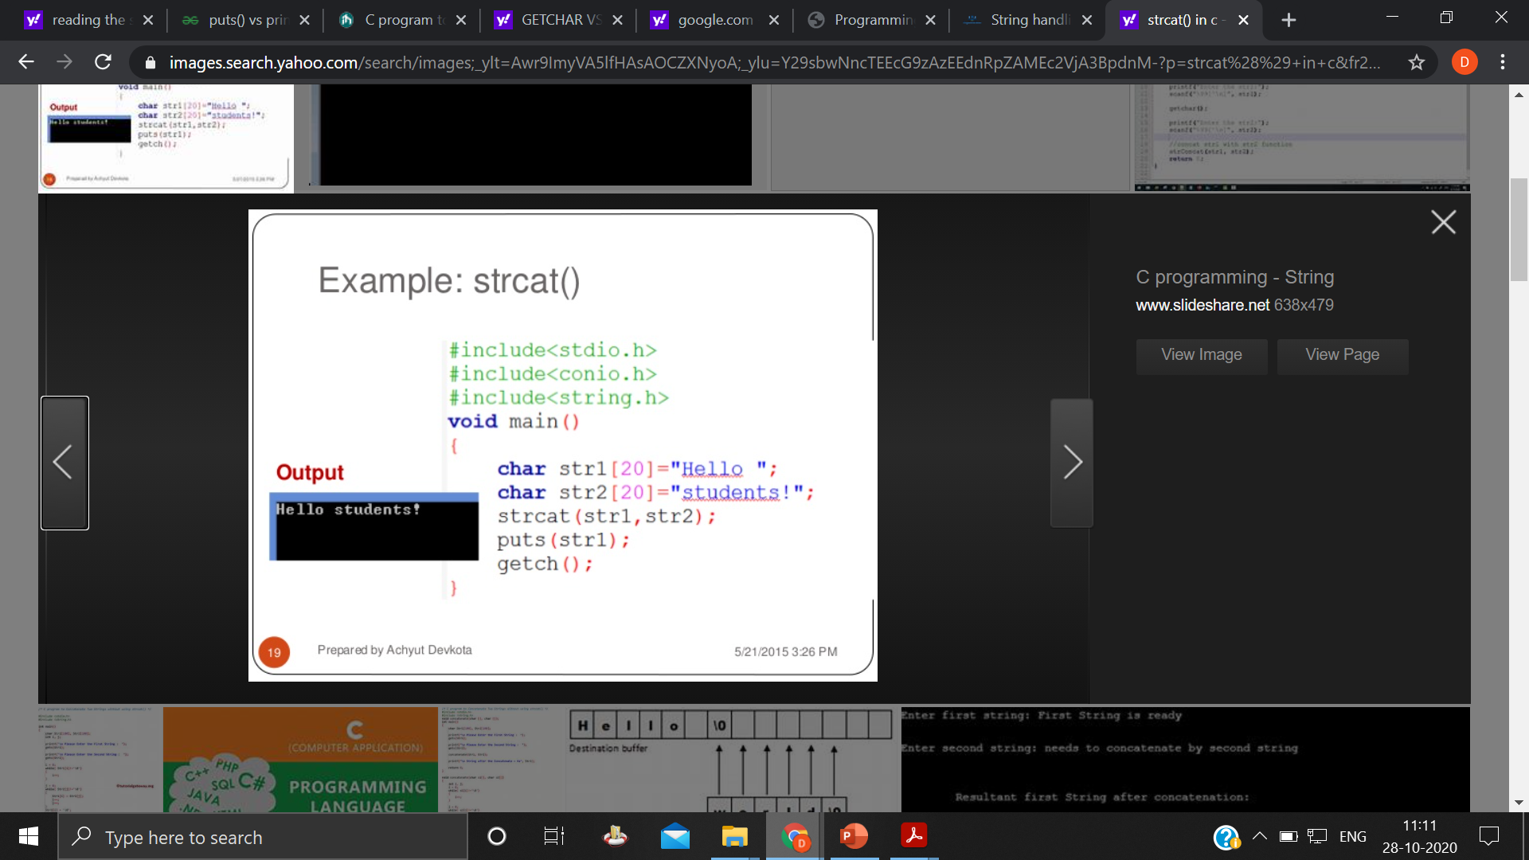
STRCAT() program

Slide 7
STRCMP()
The strcmp function compares two strings identified by the arguments and has a value 0 if they are equal.
if they are not, it has the numeric difference between the first nonmatching characters in the strings. It takes the form:
strcmp(string1, string2);
string1 and string2 may be string variables or string constant.
Example are:
strcmp(name1, name2);
strcmp(name1, “john”);
strcmp(“ram”, “sham”);

Slide 8
STRCMP() example
#include<stdio.h>
#include<string.h>
void main()
{
char s1[15] = "Hello World";
char s2[15] = "Hello world";
int cmp,cmpi,cmpn;
//
cmp = strcmp(s1,s2);
//this function will compare 5 character
//and return the result.
cmpn = strncmp(s1,s2,5);
//ignores the case and return result
cmpi = strcmpi(s1,s2);
printf("\nUsing strcmp() result is %d",cmp);
printf("\nUsing strncmp() result is %d",cmpn);
printf("\nUsing strcmpi() result is %d",cmpi);
}
Output:
Using strcmp() result is -1 Using strncmp() result is 0. Using strcmpi() result is 0

Slide 9
STRCpy()
The strcpy function works almost like a string assignment operator. It takes the form:
strcpy(string1, string2);
It assign the content of string2 to string1. string2 may be a character array variable or a string constant. For example, the statement
strcpy(city, “DELHI”);
Will assign the string ”DELHI” the string variable city.
Similary, the statement strcpy(city1, city2);
Will assign the content string variable city2 to the string variable city1.

Slide 10
STRCpy() example
#include <stdio.h>
#include <string.h>
int main() {
char str1[20] = "C programming";
char str2[20];
// copying str1 to str2
strcpy(str2, str1);
puts(str2); // C programming
return 0;
}

Slide 11
STRlen()
This function counts and returns the number of characters in a string. It takes the form
n = strlen(string);
Where n is the integer variable, which receive the value of the length of the string.
The counting ends at the first null character.

Slide 12
STRlen()example
#include <stdio.h>
#include <string.h>
int main()
{
char a[20]="Program";
char b[20]={'P','r','o','g','r','a','m','\0'};
// using the %zu format specifier to print size_t
printf("Length of string a = %zu \n",strlen(a));
printf("Length of string b = %zu \n",strlen(b));
return 0;
}

